Slide 1

DevOps Tools of the Trade
Warren Wong

Slide 2

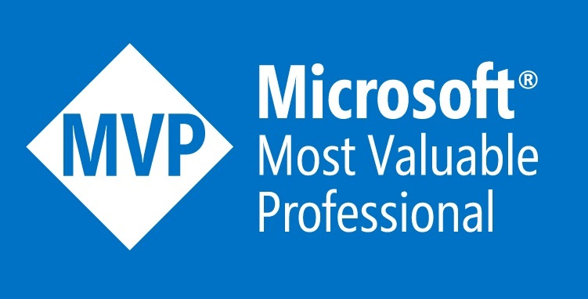
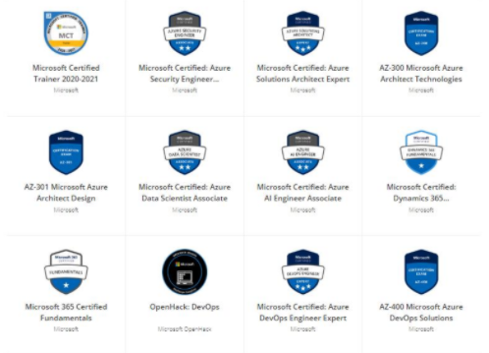
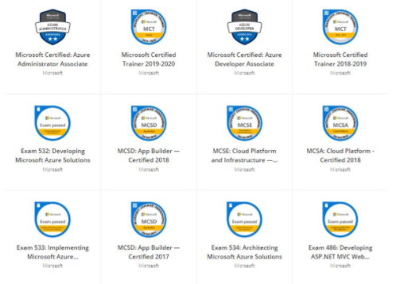
Who Am I
1
The ONLY Microsoft Most Valuable Professional in Hong Kong
2
Microsoft Certified Trainer with 15+ Cloud Certificates
3
Former Microsoft Cloud Solution Architect
Find me at https://www.linkedin.com/in/warren-wong/

Slide 3
Innovate at scale. Deliver with confidence. Operate reliably.
Microsoft DevOps Solution
Develop
Visual Studio
Deliver faster and more reliably with GitHub and Microsoft Azure
Collaborate
Operate
Deliver
Azure Monitor
Azure Policy
Azure Automation
Azure Security Center
Azure Boards
Azure Pipelines
Azure Lab Services

Slide 4

Unleashing innovation
@
GitHub brings open source workflows to your organization; breaking down silos and enabling InnerSource through:
Expertise sharing
Cross-team collaboration
Improved code reuse
Increased velocity
Secure workflows

Slide 5





Introducing Azure DevOps
Azure Boards
Azure Pipelines
Azure Repos
Deliver value to your users faster using proven agile tools to plan, track, and discuss work across your teams.
Build, test, and deploy with CI/CD that works with any language, platform, and cloud. Connect to GitHub or any other Git provider and deploy continuously.
Get unlimited, cloud-hosted private Git repos and collaborate to build better code with pull requests and advanced file management.
Azure Test Plans
Azure Artifacts
➔
Test and ship with confidence using manual and exploratory testing tools.
Create, host, and share packages with your team, and add artifacts to your CI/CD pipelines with a single click.
https://azure.com/devops
Notes:
So does TFS

Slide 6


Azure Pipelines
Microsoft Open Source
Free unlimited build minutes for public projects
Up to 10 free parallel jobs across Windows, Linux and macOS
➔
https://azure.com/pipelines
Notes:
All the builds you need, using the power of Azure you get one service that gives you unlimited build minutes where you can build on Windows Mac and Linux in parallel using a single build YAML file.

Slide 7

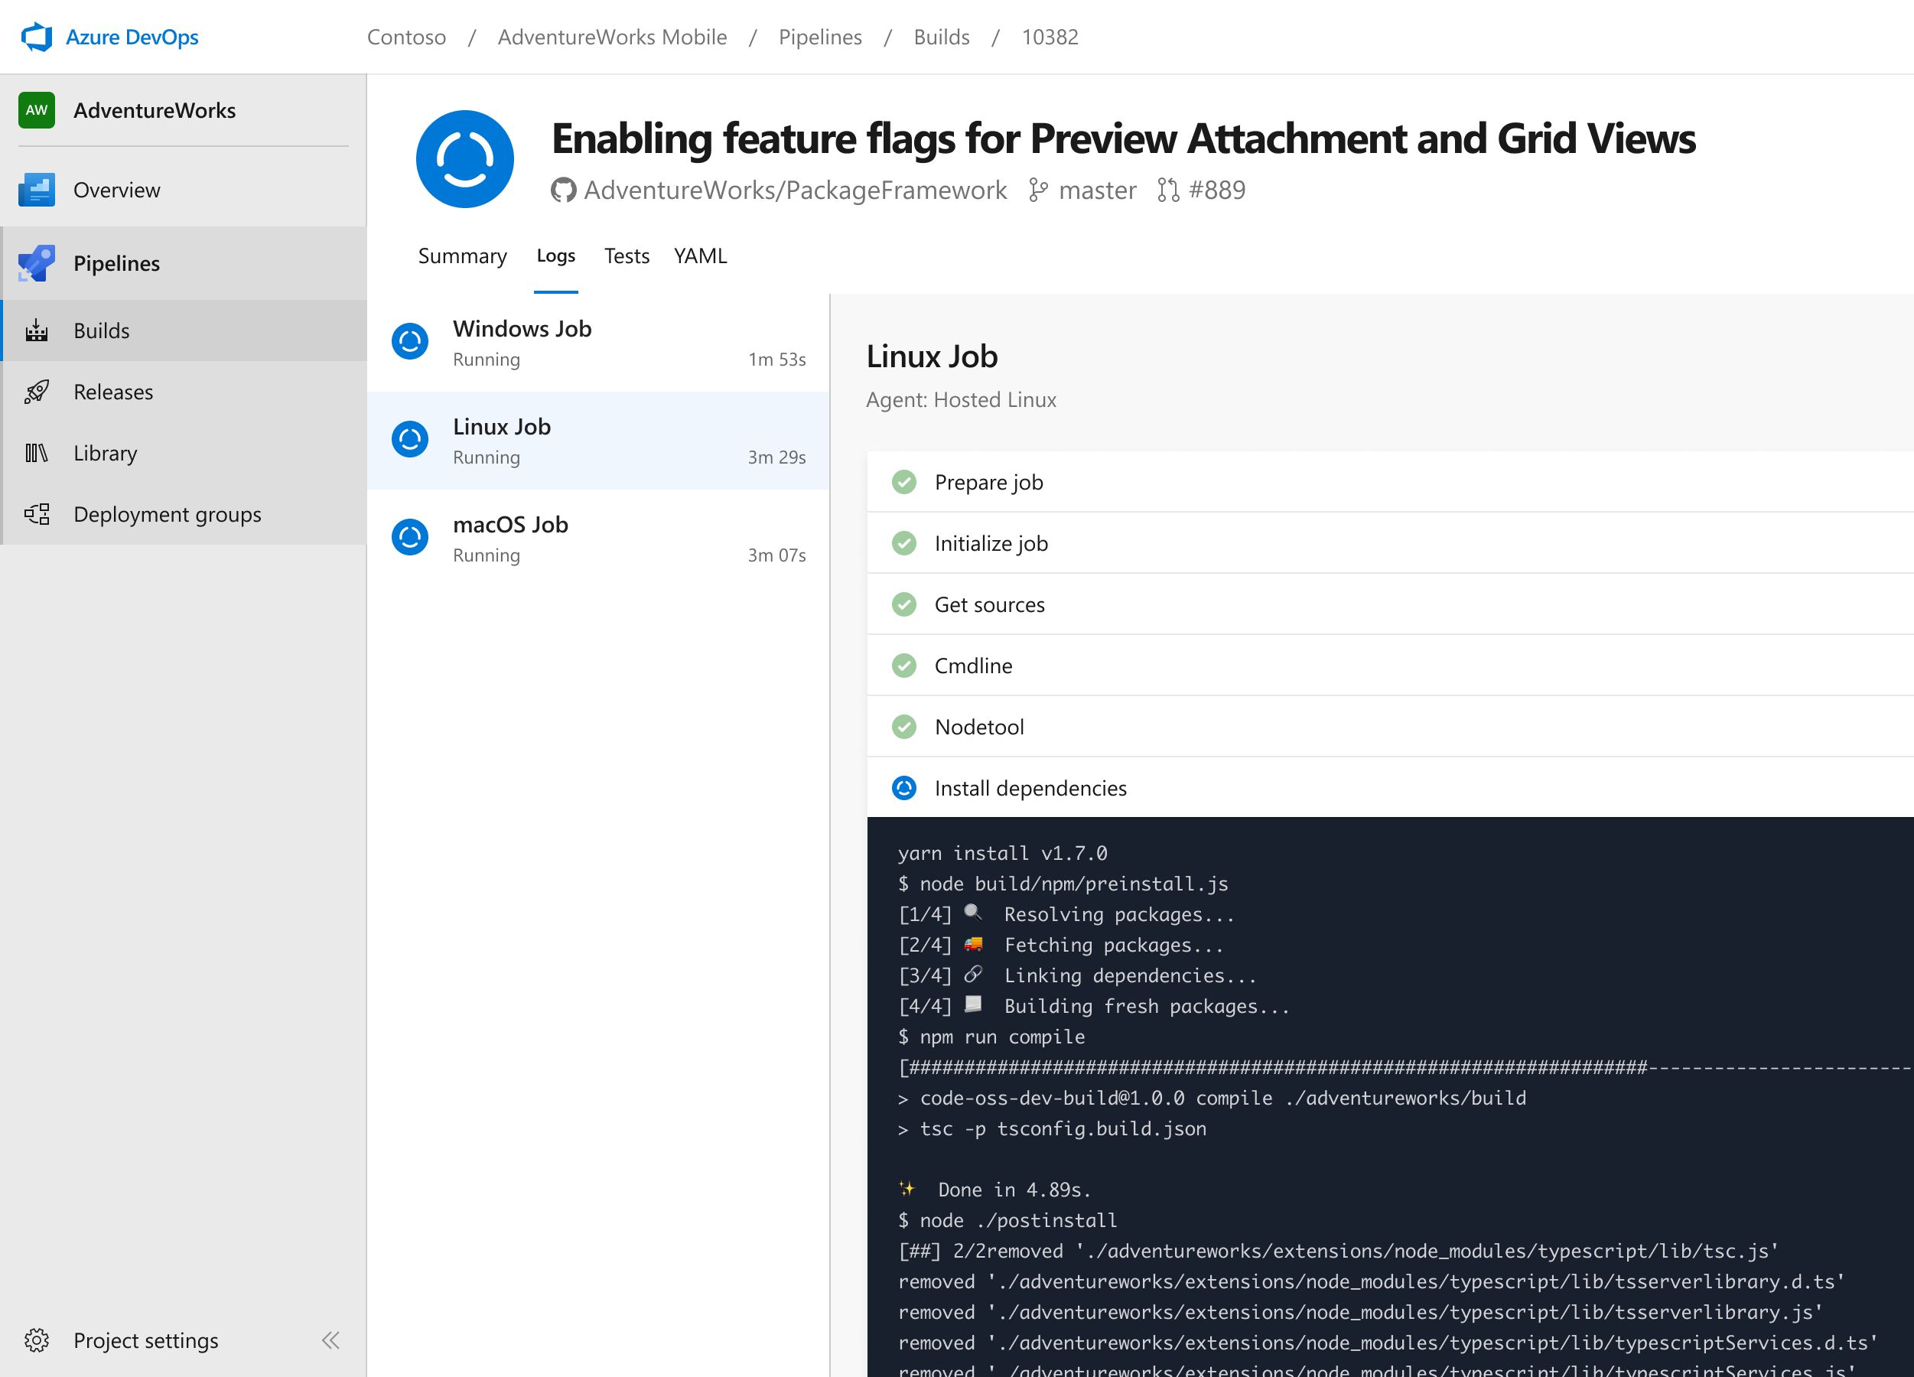


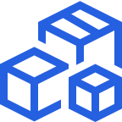

Azure Pipelines
Cloud-hosted pipelines for Linux, Windows and macOS, with unlimited minutes for open source
Any language, any platform, any cloud
Build, test, and deploy Node.js, Python, Java, PHP, Ruby, C/C++, .NET, Android, and iOS apps. Run in parallel on Linux, macOS, and Windows. Deploy to Azure, AWS, GCP or on-premises
Extensible
Explore and implement a wide range of community-built build, test, and deployment tasks, along with hundreds of extensions from Slack to SonarCloud. Support for YAML, reporting and more
Containers and Kubernetes
Easily build and push images to container registries like Docker Hub and Azure Container Registry. Deploy containers to individual hosts or Kubernetes.
Best-in-class for open source
Ensure fast continuous integration/continuous delivery (CI/CD) pipelines for every open source project. Get unlimited build minutes for all open source projects with up to 10 free parallel jobs across Linux, macOS and Windows
➔
https://azure.com/pipelines
Notes:
Azure Pipelines is the perfect launchpad for your code – automating your builds and deployments so you spend less time with the nuts and bolts and more time being creative

Slide 8

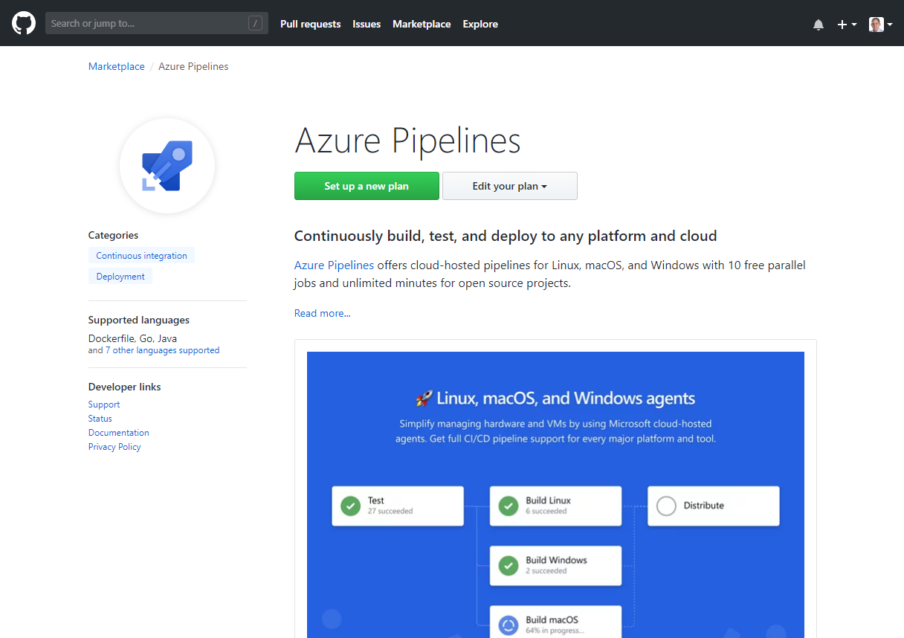
Integrated with GitHub
Azure Pipelines available now to any developer from the GitHub Marketplace

Slide 9
Azure DevOps
Azure Boards
Azure Pipelines
Azure Repos
Deliver value to your users faster using proven agile tools to plan, track, and discuss work across your teams.
Build, test, and deploy with CI/CD that works with any language, platform, and cloud. Connect to GitHub or any other Git provider and deploy continuously.
Get unlimited, cloud-hosted private Git repos and collaborate to build better code with pull requests and advanced file management.
Azure Test Plans
Azure Artifacts
➔
Test and ship with confidence using manual and exploratory testing tools.
Create, host, and share packages with your team, and add artifacts to your CI/CD pipelines with a single click.
https://azure.com/devops
Notes:
So does TFS

Slide 10


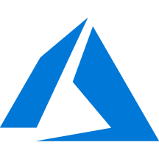


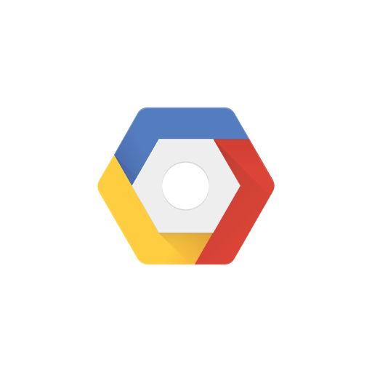

The Lab Today
In this lab, we’ll be illustrating the integration and automation benefits of Azure DevOps. We will take on the role of helping a fictitious airline—Contoso Air—that has developed their flagship web site using Node.js. To improve their operations, they want to implement pipelines for continuous integration and continuous delivery so that they can quickly update their public services and take advantage of the full benefits of DevOps and the cloud.
Azure Pipelines
Microservice, data and infrastructure deployments
PaaS, CaaS & IaaS
Azure Artifacts
Azure Repos
Lab Source Code:
https://github.com/Microsoft/ContosoAir/
https://github.com/somethingwentwell/ContosoAir

